Slide 1
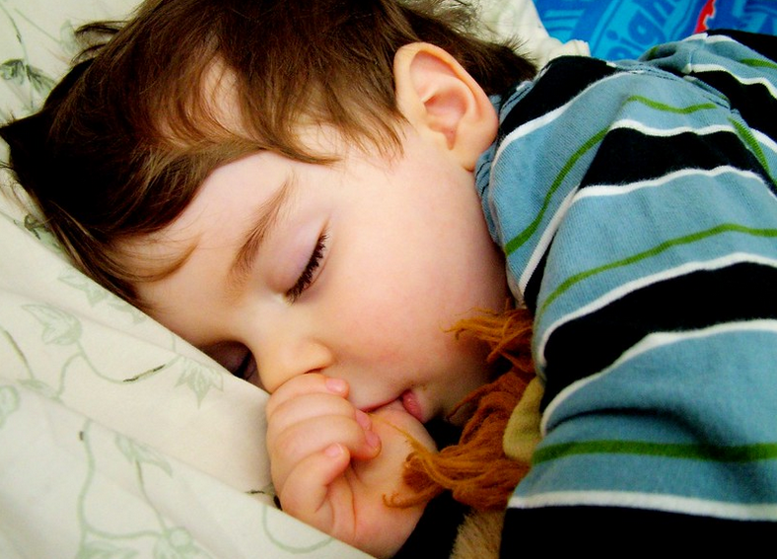


Sleeping like a baby is a fundamental human right

Slide 2

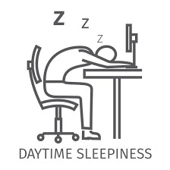



Obstructive Sleep Apnea
Snoring and
Choking
Upper Airway Obstruction
Decreased Blood Oxygen Content
Resulting In
Excessive Daytime Sleepiness
Fall Asleep
Arousal From Sleep

Slide 3




OSA Comorbidities
OSA Patients
5x
Heart Attacks
Stroke
More likely to die of Cardiac Complications
Atrial Fibrillation
High Blood Pressure
Young T, et al. Sleep. 2008;31(8):1071.

Slide 4

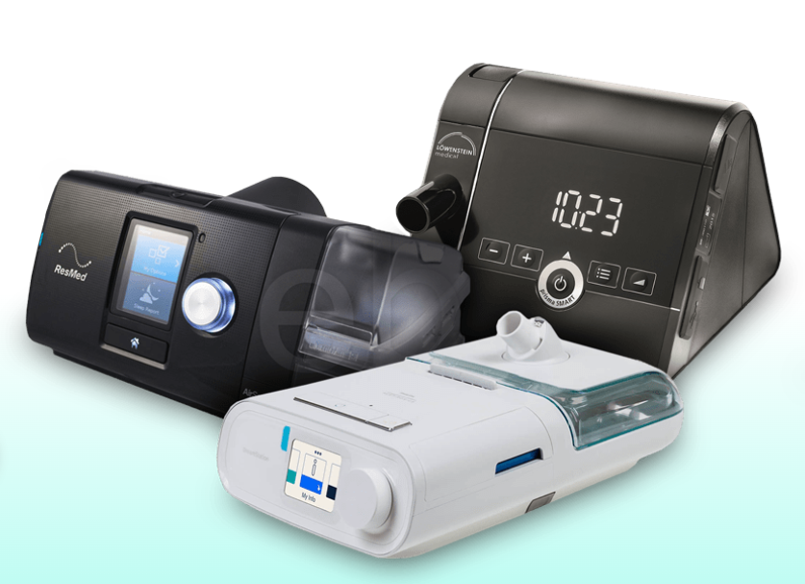
PAP Solution
Gold Standard
CPAP - Continuous Positive Airway Pressure
The most effective treatment for OSA
Patil SP, et al. J Clin Sleep Med. 2019;15(2):301–34.

Slide 5



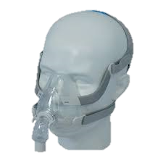
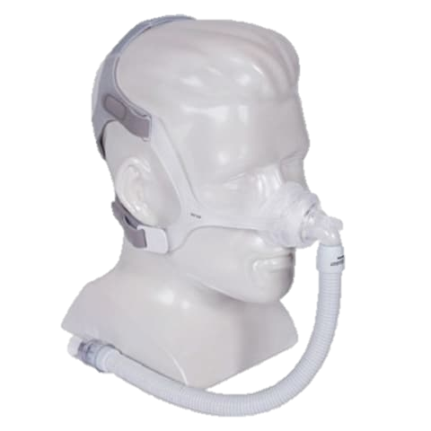


CPAP Problems
Skin & Nasal Irritation
Straps
Air Leakages
Nasal Congestion
Claustrophobia

Slide 6
CPAP Adherence
Majority of OSA patients do not adhere to the most effective treatment (CPAP)
44%
Adhere
56%
Not
Adhere
According to Dr. Yona Vaisbuch and Dr. Uri Alkan clinics
Notes:
10% Reject 15% withdraw on top of the 60% which would actually adhere

Slide 7
Need
A BETTER WAY TO TREAT MODERATE TO SEVERE OSA IN CPAP NON-COMPLIANT ADULT PATIENTS IN ORDER TO IMPROVE ADHERENCE
Must have
Adherence > 75% after 3 months
AHI* < 15
Price < $1300
Safe
*AHI stands for Apnea Hypopnea Index which if below 15, reduces the severity to mild

Slide 8
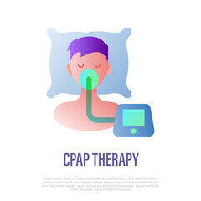
CPAP Masks Market
TAM
$1.7B
SAM (56%)
$950M
Mask Fits All CPAP Devices
BCC Publishing: Continuous Positive Airway Pressure (CPAP) Devices: Global Markets 2020
Notes:
CPAP mask market is worth $1.9B
Yearly Mask Sales^{[1]}:
8M USA + 2.5M Global
[1] Industry Insiders and Journals according to RemSleep Holding report
[2] BCC Publishing: Continuous Positive Airway Pressure (CPAP) Devices: Global Markets 2020 (evaluation of mask market with CAGR of 6.7%)

Slide 9
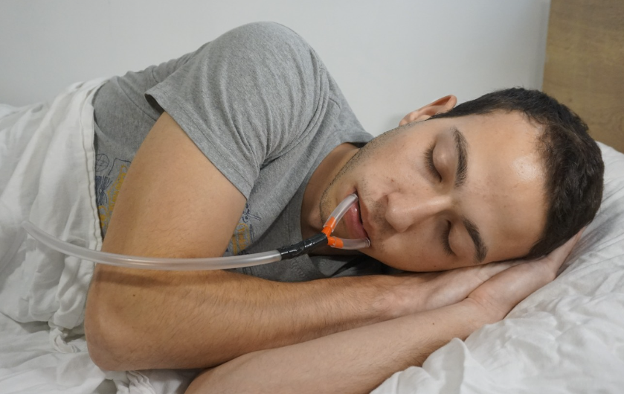
Our Invention
Efficacy of CPAP with the
comfort of a mouthguard

Slide 10
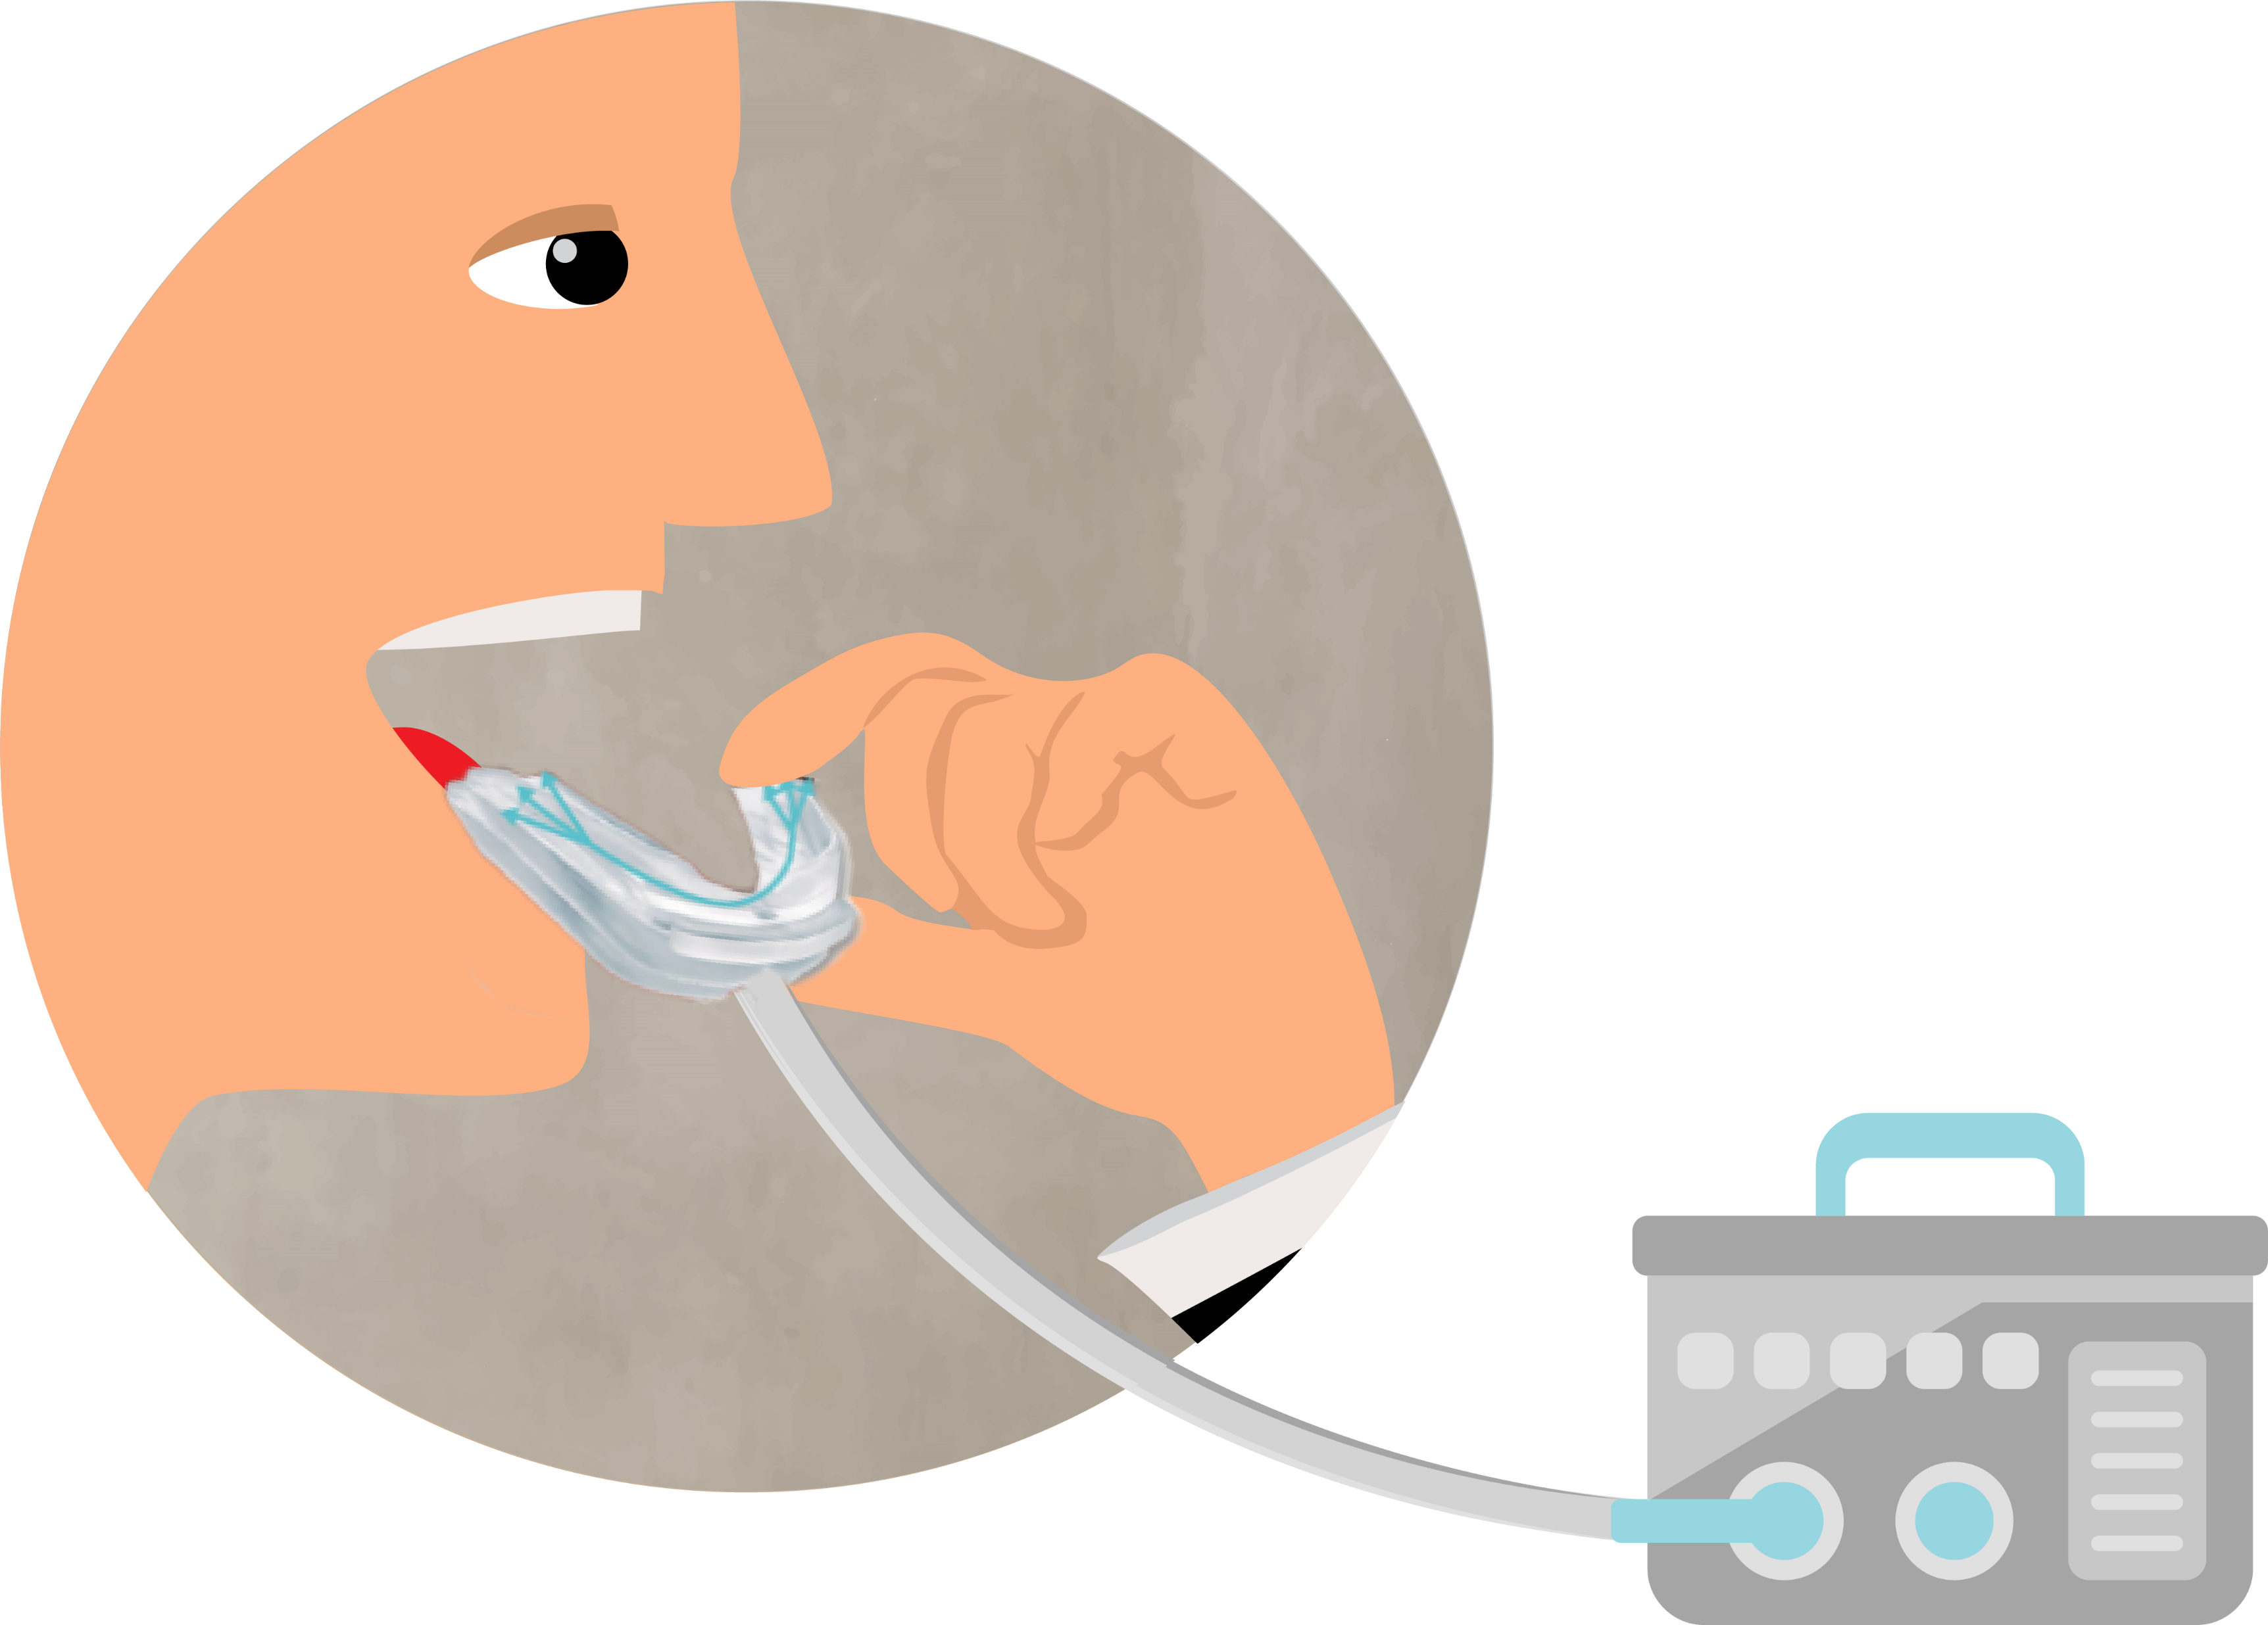
Features
Intra-Oral Airflow
Facial Pressure Sensation Free
Mouth Guard
No straps
Lower pressure required for treatment due to direct airflow
Any Standard CPAP

Slide 11
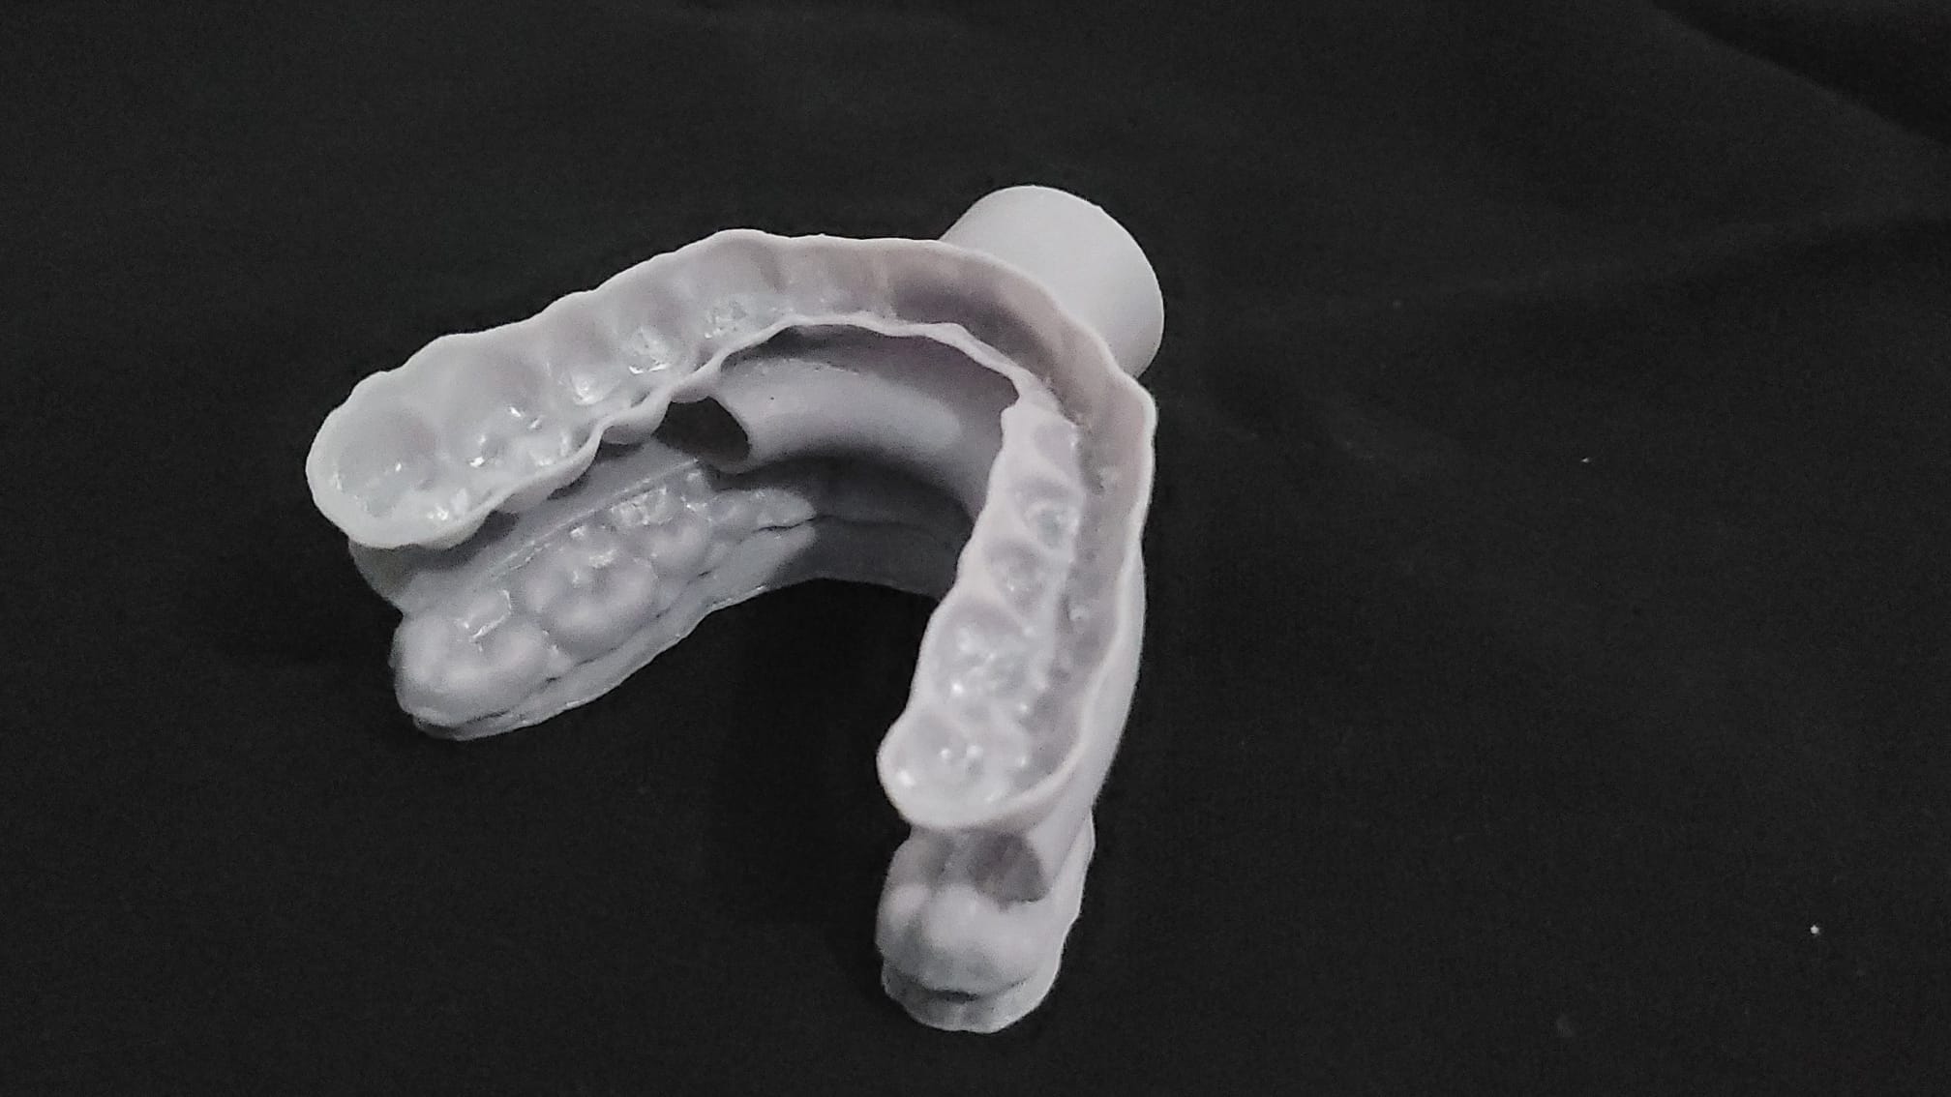

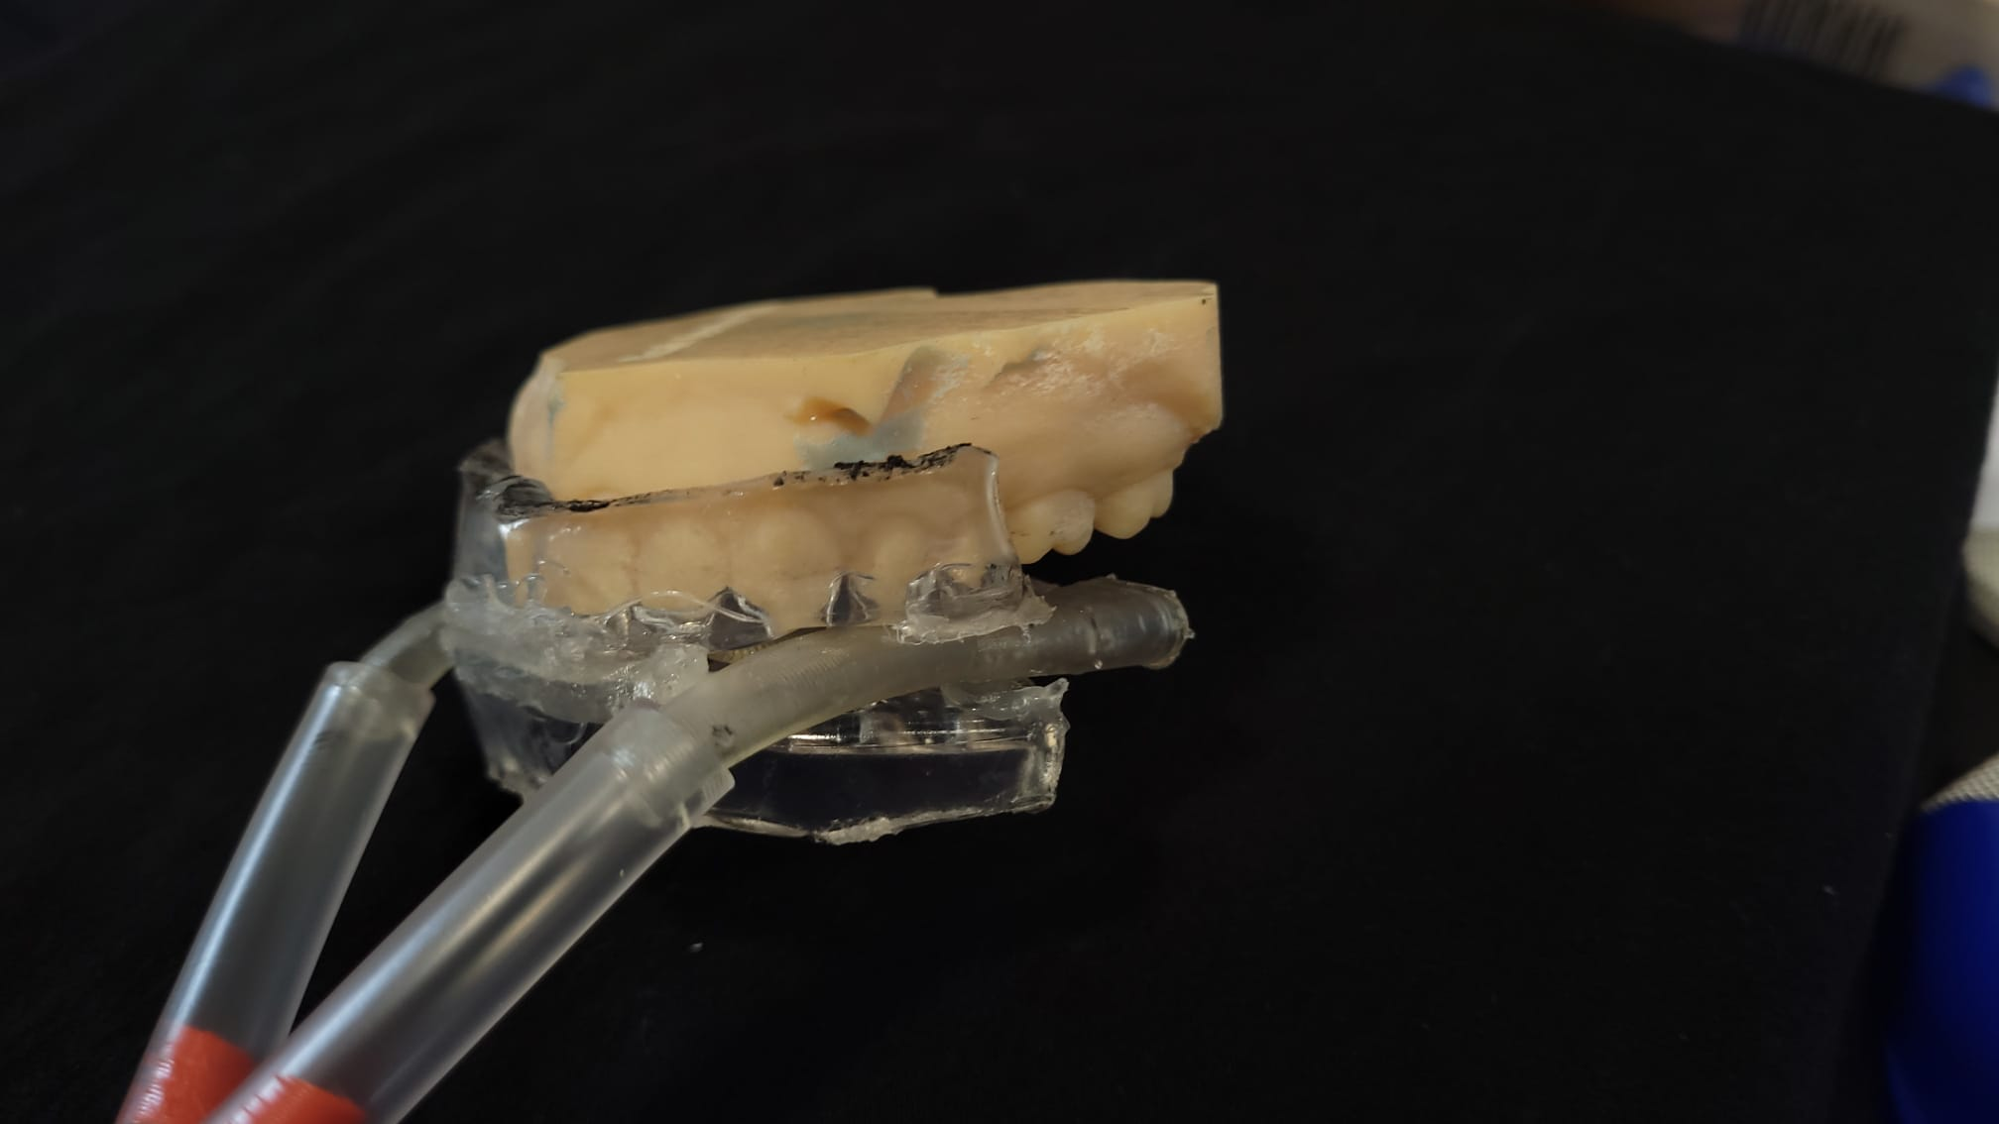
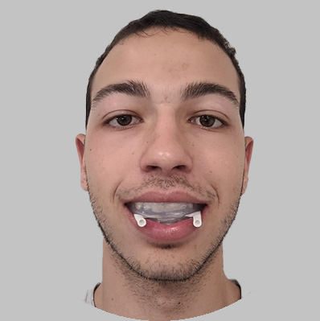
De-Risking
TECH FEASIBILITY
Initial Prototypes for proof of concept testing

Slide 12





De-Risking
Intellectual Property
REGULATION
REIMBURSMENT
Provisional patent Acquired
Class II
Coverage
510(K) De-novo
HCPC code
Freedom to Operate
Clinical trial
(safety, efficacy)

Slide 13
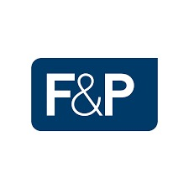


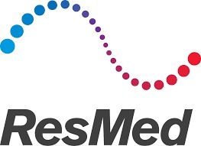


De-Risking
BUSINESS MODEL
VS
Major Partnership
Distributers Ecommerce
Constant flow of revenue

Slide 14

Timeline
Months
Provisional Patent
Completed
Advanced prototyping
2023
6
Patent approved
Clinical
Study
2024
4
2024
Reimbursement Coverage
2025
2
FDA Clearance
6
2025
Market Entrance
2026
Notes:
Safety test
Efficacy comfort test clinical study 4 months
Disinfection
Durability

Slide 15

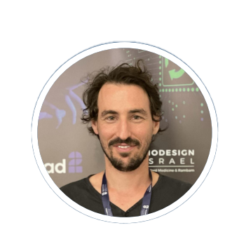
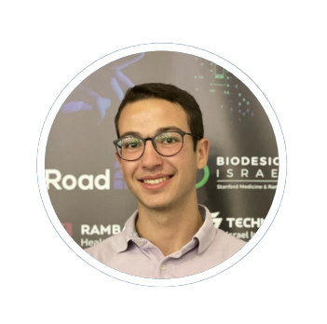
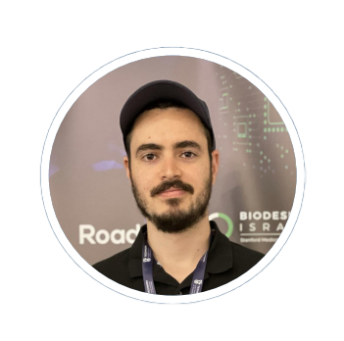
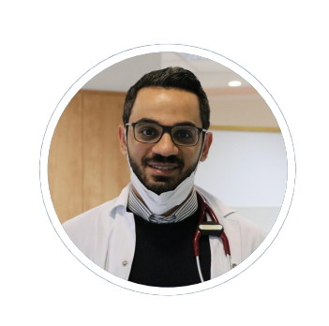
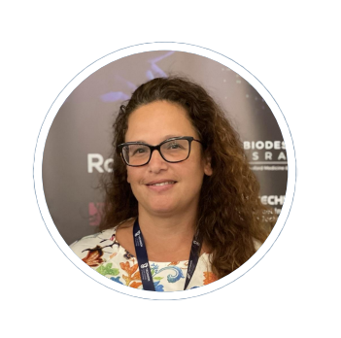

Our Winning Team
Or Givol Resident for Pediatric Medicine in Heillel-Yaffe
Advisory Board
Dr. Yona Vaisbuch Founder and director
ENT surgeon, Rambam
Dr. Uri Alkan
ENT, Head and Neck Surgery. Head of Sleep medicine and surgery clinic. Rabin Medical Center
Noah Bernten Mechanical Engineering Student at the Technion
Yosef Ali Biomedical Engineering Student at the Technion
Dr. Yael Nir
Director of Business development Harvard Medical School
Oded Tamir
Entrepreneur, C-level Executive, Executive Chairman
Elias Nasrallah Medical Doctor Specialized in Pediatrics
Limor Provizor Trudi SW Department Manager in Biosense Webster
Biodesign Instructor: Ido Yohanan VP of R&D, Maverick Medical Stanford GFIT
Additional thanks: Guy Becker - Product Manager, Microsoft Dalia & Shir -
Dr. Talma Cohen - Rambam

Slide 16

Sleep well and breathe easy with Breazzzy
Join in helping people who suffer from OSA

